Slide 1
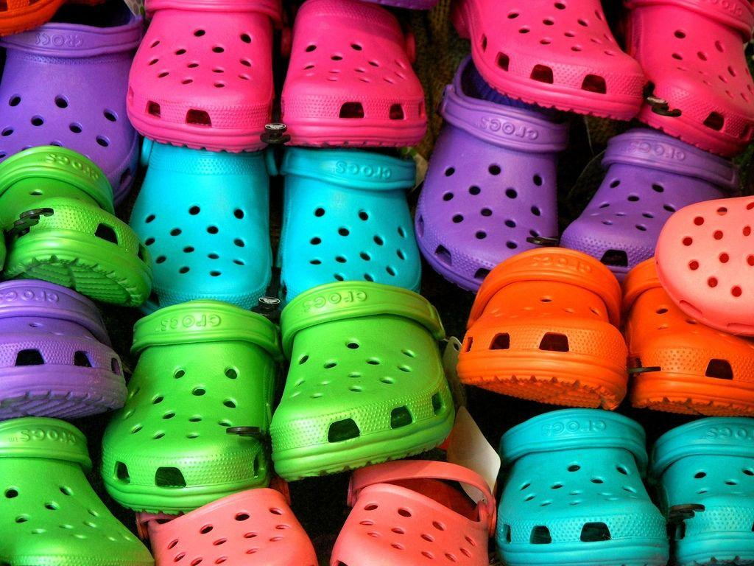

$CROX
December 2021 Target Price: $188.98

Slide 2






Table of Contents
Company Overview…………………………………………….......Slides 4-6
Industry Analysis……………………………………………............Slides 7-9
Investment Thesis……………………………………………..........Slides 10-13
Risk and Mitigants…………………………………………………….Slides 14-15
Valuation……………………………………………........................Slides 16-19
Appendix……………………………………………........................Slides 20-23

Slide 3
Executive Summary
Recommending a BUY on Crocs at a target price of $189.72 representing an upside of 16.3%
Investment Thesis
Valuation Football Field
Penetration into Asia
Flagship Products & Innovation
Sandals Growth
Implied Share Price
 | Perpetuity | Exit EBITDA | Comps
Bear Case | 117.46 | 213.23 | 128.02
Base Case | 126.65 | 235.29 | 159.70
Bull Case | 134.32 | 259.27 | 187.86
Weighting | 25% | 50% | 25%
Base Case | 126.65 | 235.29 | 159.70
Implied Price |  |  | $188.98
Implied Upside |  |  | 16.3%

Slide 4
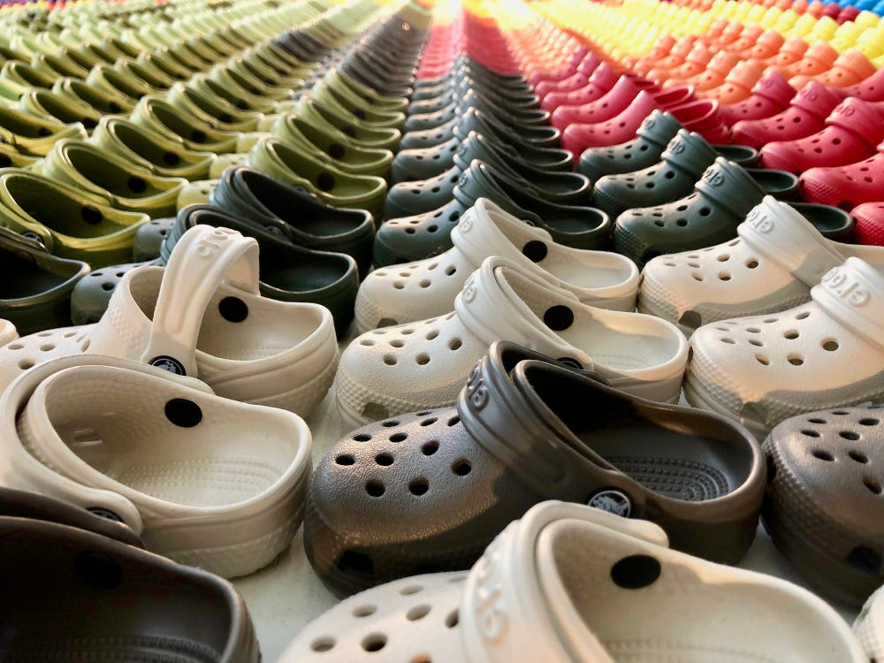
Company Overview
Industry Analysis
Investment Thesis
Risks and Mitigations
Valuation
Appendix

Slide 5
Company Overview
Company Highlights
Revenue Segmentation (LTM Q2’21) and Key Figures
Crocs designs, develops, manufactures, markets and distributes casual lifestyle footwear and accessories for men, women and children
Footwear products include sandals, wedges, flips, slides, clogs and Jibbitz charms
The company sells its products in approximately 80 countries through wholesalers, retail stores, e-commerce sites and third-party marketplaces
As of December 31, 2020, Crocs had 186 outlet stores, 100 retail stores, 65 store-in-stores and 13 company-operated e-commerce sites
Current Share Price ($USD) | 168.04
Enterprise Value ($B) | 10.34
Market Cap ($B) | 9.89
P/E | 23.29
EV/EBITDA | 13.38
Shares Outstanding (M) | 61.5
Regional and Channel Segmentation
Stock Performance
Company Overview
Industry Analysis
Investment Thesis
Risks & Mitigants
Valuation

Slide 6



Management
Senior Management
Compensation Structure
Andrew Rees - CEO & Director
Became CEO of Crocs in 2017
Formerly the Managing Director of L.E.K Consulting
Prior to L.E.K Consulting, held various executive positions at Reebok International
Helped to build the sustainability and profitability of Reebok’s retail channel
Michelle Poole - President
President of Crocs since 2020
Held several executive roles at Crocs since 2014
Three decades of brand-building experience at Sperry Top-Sider, Timberland and Converse
Free Cash Flows since 2017
Anne Mehlman - Executive VP & CFO
Executive VP and CFO of Crocs since 2018
VP of Corporate Finance at Crocs from 2011-2016
Previously the CFO of Zappos.com
Company Overview
Industry Analysis
Investment Thesis
Risks & Mitigants
Valuation

Slide 7
Company Overview
Industry Analysis
Investment Thesis
Risks and Mitigations
Valuation
Appendix

Slide 8
Industry Analysis
Footwear Industry Market Share and Outlook
U.S. Footwear Market Segmentation
Crocs has a 20% market share in the $6 billion global clogs industry that has outpaced casual footwear growth
Economic recovery from COVID-19, increased consumer spending and growth in global footwear demand is favorable towards Crocs’ future growth
China is the 2nd largest footwear market in the world, contributing about 20% of global footwear revenues
China’s footwear industry is expected to grow at a CAGR of 16% from 2021-2025, as increased wages, overall buying power and population will support footwear demand
China Footwear Revenue
U.S. Footwear Revenue
Company Overview
Industry Analysis
Investment Thesis
Risks & Mitigants
Valuation

Slide 9
Competitive Analysis
Gross Margin % Excellence
Consistent Decline in SG&A Margin %
Strong Interest Coverage
Fast Cash Conversion Cycle
Company Overview
Industry Analysis
Investment Thesis
Risks & Mitigants
Valuation

Slide 10
Company Overview
Industry Analysis
Investment Thesis
Risks and Mitigations
Valuation
Appendix

Slide 11
Investment Thesis I – Penetration into Asia
Growth in Asian Markets
Sourcing and Manufacturing
Crocs sees Asia as the company’s greatest long-term potential with large markets available, such as China, India and Southeast Asia
Currently, Mainland China reflects only 5% of total revenue, compared to the company’s competitors with 20%, making Crocs underpenetrated in the region
Crocs is estimating 10% of total revenue to come from Mainland China and 25% from Asia by 2026 (30% CAGR) by utilizing its brand, digital and marketing capabilities
Vast majority of store openings in Asia have been in China (the most future store openings out of all of Crocs’ geographical regions)
Major partner groups in Asia have significant resources that are pivotal to Crocs’ growth
Opening 2 distribution centres in Indonesia that will be operating by end of 2021
Signed an agreement to open a major distribution facility in India in a year
Confidence in Asia’s partner base and optimistic about penetrating new regions for manufacturing
Crocs Asia Revenue Growth
Future Geographical Segmentation
Company Overview
Industry Analysis
Investment Thesis
Risks & Mitigants
Valuation

Slide 12
Investment Thesis II – Sandals Opportunity
Outlook
Strategy
The sandals market ($30+ billion total addressable market) is seen as fragmented with no clear leader, and Crocs can grow market share in the category
No major player concentrates on the sandals industry and smaller players are not equipped with marketing and investment capacity
Women make up two-thirds of the sandal market making them a major and high buying-frequency consumer
Crocs’ sandals revenue had a 10% CAGR from 2017-2019 (pre-COVID)
Crocs expects to grow their sandals category 4x by 2026
Sell and market with 4 sub-categories: icon, style, comfort and adventure
Crocs appeals and covers all types of consumers in the sandals market whereas other competitors focus on only one sub-category (allows the company to successfully penetrate the market)
Framework: drive sandal awareness, convert existing clog customers and utilize Crocs’ marketing channels
Sandals Revenue Growth
Company Overview
Industry Analysis
Investment Thesis
Risks & Mitigants
Valuation

Slide 13
Investment Thesis III – Flagship Products and Innovation
Margin Stability and Growth
Clogs and Innovation
Crocs is the market leader in clogs and continues to grow the category and the company’s brand
Clog revenues increased 101% in Q2 2021 to represent nearly 75% of footwear sales
Prudent investments to support long-term growth (building, automating and expanding distribution centres in EMEA and U.S.)
Top quality marketing with collaborations and influencers, such as Foot Locker, Balenciaga and Justin Bieber, and social media engagements, such as TikTok challenges
Jibbitz Charms
DTC Same-Store Sales Growth
Personalization is a global megatrend and Jibbitz charms drives relevance for the brand
Revenues more than tripled in Q2 2021, more than doubled in Q3 compared to the previous year and make up 6% of the overall business
Jibbitz customers have 2x the average lifetime value of Crocs customers who do not buy Jibbitz (also have higher average order values)
Continue to grow the Jibbitz business through assortments of partnerships with top tier celebrities
Shifted from selling single charms to packages/bundles, resulting in higher margins
Company Overview
Industry Analysis
Investment Thesis
Risks & Mitigants
Valuation

Slide 14
Company Overview
Industry Analysis
Investment Thesis
Risks and Mitigations
Valuation
Appendix

Slide 15
Risks and Mitigations
Impact
Trendiness Runs Out
Supply Chain
COVID-19
Inflation
F/X
Generic Alternatives
Likelihood
Supply Chain | Inflation | Trendiness Runs Out | COVID-19 | Generic Alternatives | F/X
Shifting production to countries with less COVID-19 cases/outbreaks to smooth production. Supply chain is intrinsically simple, making the firm more resistant to external shocks. Production for the clog is only 3 components, 2/3 are made on-site. | Affordable positioning means firm still maintains competitive advantage despite price increases. Discounts to wholesale and digital customers work to incentivize purchasing regardless of inflationary conditions. | Management has laid out substantial framework for SG&A, marketing especially. Crocs had used the explosive popularity of the clogs to gain market share but has since diversified. Clogs are now touted as timeless classics in the fashion industry. | E-commerce growth has more than made up for lockdown-related physical retail sales slowdown. Management leads the charge, setting the goal of doubling online sales’ share of top line, to over 50%. | Consumers seek out the brand specifically for its namesake, and recent collaborations with highly visible celebrities has grown brand equity from obscurity into the spotlight. Collaboration with Balenciaga further displays brand evolution. | Affordable positioning means firm still maintains competitive advantage despite price increases. Discounts to wholesale and digital customers work to incentivize purchasing regardless of inflationary conditions.
Company Overview
Industry Analysis
Investment Thesis
Risks & Mitigants
Valuation

Slide 16
Company Overview
Industry Analysis
Investment Thesis
Risks and Mitigations
Valuation
Appendix

Slide 17
Valuation
Comparables Company Analysis
Name | Ticker | Share Price | Market Cap ($M) | EV ($M) | P/E | EV/Revenue 2021 | EV/EBITDA 2021 | Debt/Equity | Gross Margin
Crocs Inc. | CROX | 162.74 | 9,888.70 | 10,341.20 | 23.3x | 4.4x | 13.4x | 1.29 | 59.7%
Deckers Outdoor Corp. | DECK | 414.53 | 11,378.10 | 10,862.80 | 25.9x | 3.3x | 15.0x | 0.15 | 53.7%
Steve Madden Ltd. | SHOO | 47.44 | 3,861.30 | 3,727.10 | 24.1x | 1.9x | 11.8x | 0.17 | 40.5%
Wolverine World Wide | WWW | 32.04 | 2,564.20 | 3,572.50 | - | 1.6x | 11.4x | 3.18 | 42.5%
Skechers U.S.A. | SKX | 46 | 7,168.70 | 7,968.00 | 18.3x | 1.3x | 9.5x | 0.74 | 49.6%
adidas AG | ADS | 286.69 | 55,070.70 | 56,342.60 | 33.5x | 2.5x | 16.9x | 0.88 | 50.4%
V.F. Corp | VFC | 73.98 | 29,058.00 | 34,538.80 | 28.2x | 3.0x | 15.7x | 2.41 | 54.6%
Nike Inc. | NKE | 168.02 | 265,945.00 | 265,040.00 | 43.4x | 5.6x | 31.7x | 1.00 | 45.4%
Bear (First Quartile) |  | 46.36 | 4688.2 | 4787.3 | 23.3x | 1.7x | 11.5x | 0.31 | 43.2%
Base (Median) |  | 121.00 | 10633.4 | 10602.0 | 25.9x | 2.8x | 14.2x | 0.94 | 50.0%
Bull (Third Quartile) |  | 257.03 | 48567.5 | 50891.7 | 33.5x | 4.1x | 16.6x | 2.13 | 54.4%
EV/EBITDA
 | Bear | Base | Bull
EBITDA 2021E | 690.0 | 690.0 | 690.0
EV/EBITDA 2021E | 11.5x | 14.2x | 16.6x
Enterprise Value | 7,934.6 | 9,797.5 | 11,453.4
Less: Debt | (843.8) | (843.8) | (843.8)
Add: Cash | 436.6 | 436.6 | 436.6
Equity Value | 7,527.4 | 9,390.3 | 11,046.2
Shares Outstanding | 58.8 | 58.8 | 58.8
Equity Value per Share | $ 128.02 | $ 159.70 | $ 187.86
Market Premium to Fair Value | (21.3%) | (1.9%) | 15.4%
EV/EBITDA Distribution
Company Overview
Industry Analysis
Investment Thesis
Risks & Mitigants
Valuation

Slide 18
Valuation
Discounted Free Cash Flow Model
In Thousands of USD | FY 2018 | FY 2019 | FY 2020 | FY 2021E | FY 2022E | FY 2023E | FY 2024E | FY 2025E | FY 2026E
12 Months Ending | 2018-12-31 | 2019-12-31 | 2020-12-31 | 2021-12-31 | 2022-12-31 | 2023-12-31 | 2024-12-31 | 2025-12-31 | 2026-12-31
EBITDA | 92,194.0 | 152,862.0 | 241,743.0 | 689,965.3 | 857,820.1 | 1,025,778.0 | 1,208,373.6 | 1,399,075.1 | 1,600,705.1
EBIT | 62,944.0 | 128,649.0 | 214,124.0 | 640,309.4 | 802,444.8 | 959,945.4 | 1,130,776.5 | 1,309,179.4 | 1,497,472.8
Tax Rate |  |  |  | 23.0% | 25.0% | 25.0% | 25.0% | 25.0% | 25.0%
EBIAT (NOPAT) |  |  |  | 493,038.2 | 601,833.6 | 719,959.0 | 848,082.4 | 981,884.6 | 1,123,104.6
(+) Depreciation |  |  |  | 49,655.9 | 55,375.2 | 65,832.6 | 77,597.1 | 89,895.7 | 103,232.3
(+) Stock-Based Compensation |  |  |  | 26,995.7 | 32,664.7 | 38,544.4 | 45,096.9 | 51,861.5 | 59,122.1
(+) Deferred Income Taxes |  |  |  | 35,104.9 | 42,476.9 | 50,122.8 | 58,643.6 | 67,440.2 | 76,881.8
Unlevered CFO |  |  |  | 604,794.7 | 732,350.5 | 874,458.8 | 1,029,420.1 | 1,191,081.9 | 1,362,340.8
(-) Changes in Net Working Capital |  |  |  | 2,620.1 | 28,829.4 | 516.2 | 18,512.6 | 17,660.3 | 19,835.2
(-) Capital Expenditures |  |  |  | (75,000.0) | (83,011.5) | (97,953.6) | (114,605.7) | (131,796.6) | (150,248.1)
Unlevered FCF |  |  |  | 532,414.8 | 678,168.4 | 777,021.3 | 933,327.0 | 1,076,945.6 | 1,231,927.9
Discount Factor |  |  |  | 9.6% | 109.6% | 209.6% | 309.9% | 409.9% | 509.9%
PV of Unlevered FCF |  |  |  | 525,012.1 | 577,886.3 | 572,167.9 | 593,658.0 | 591,945.8 | 585,139.2
Perpetuity Approach
FCF in Last | 1,231,927.9
FCF t+1 | 1,256,566.5
Long term growth rate | 2.0%
Terminal Value | 9,157,601.2
Present Value of Terminal Value | 4,349,663.0
Present Value of Stage 1 CF | 3,445,809.4
Enterprise Value | 7,795,472.4
Less: Net Debt | (407,228.0)
Equity Value | 7,388,244.4
Diluted Shares | 58,800.0
Equity Value per Share | $ 125.65
Current Share Price | $ 162.74
Implied Premium (Discount) | (22.6%)
Exit EBITDA Multiple Approach
Terminal Year EBITDA | 1,600,705.1
Terminal Value EBITDA Multiple | 14.2x
Terminal Value | 22,730,012.5
Present Value of Terminal Value | 10,796,265.7
Present Value of Stage 1 CF | 3,445,809.4
Enterprise Value | 14,242,075.0
Less: Net Debt | (407,228.0)
Equity Value | 13,834,847.0
Diluted Shares | 58,800.0
Equity Value per Share | $ 235.29
Current Share Price | $ 162.74
Implied Premium (Discount) | 44.7%
WACC
Cost of Debt | 4.1%
Tax Rate | 23.0%
After-Tax Cost of Debt | 3.2%
Risk-Free Rate | 1.5%
Beta | 1.8
Market Risk Premium | 8.5%
Cost of Equity | 16.8%
Market Value of Equity | 9,880,752.0
Equity Weight | 92.1%
Total Debt | 843,829.0
Debt Weight | 7.9%
WACC | 15.7%
Company Overview
Industry Analysis
Investment Thesis
Risks & Mitigants
Valuation

Slide 19
Valuation Summary
Target Price $188.98
Valuation Football Field
Target Price $188.98
Implied Share Price
 | Perpetuity | Exit EBITDA | Comps
Bear Case | 117.46 | 213.23 | 128.02
Base Case | 126.65 | 235.29 | 159.70
Bull Case | 134.32 | 259.27 | 187.86
Weighting | 25% | 50% | 25%
Base Case | 126.65 | 235.29 | 159.70
Implied Price |  |  | $188.98
Implied Upside |  |  | 16.3%
RIG vs. Analyst Targets
Company Overview
Industry Analysis
Investment Thesis
Risks & Mitigants
Valuation

Slide 20
Company Overview
Investment Thesis
Investment Thesis
Risks and Mitigations
Valuation
Appendix

Slide 21
Sensitivity
Perpetuity Approach
Exit EBITDA Approach
 | Long-term growth rate
WACC |  | 1.25% | 1.50% | 1.75% | 2.00% | 2.25% | 2.50% | 2.75%
 | 14.2% | 137.02 | 138.87 | 140.79 | 142.79 | 144.88 | 147.05 | 149.32
 | 14.7% | 131.45 | 133.14 | 134.88 | 136.70 | 138.59 | 140.55 | 142.60
 | 15.2% | 126.29 | 127.83 | 129.42 | 131.07 | 132.79 | 134.57 | 136.43
 | 15.7% | 121.50 | 122.90 | 124.36 | 125.65 | 127.43 | 129.05 | 130.74
 | 16.2% | 117.03 | 118.32 | 119.65 | 121.03 | 122.46 | 123.94 | 125.48
 | 16.7% | 112.86 | 114.05 | 115.27 | 116.54 | 117.85 | 119.20 | 120.61
 | 17.2% | 108.96 | 110.05 | 111.18 | 112.34 | 113.55 | 114.79 | 116.08
 | Exit EBITDA Multiple
WACC |  | 12.7x | 13.2x | 13.7x | 14.2x | 14.7x | 15.2x | 15.7x
 | 14.2% | 229.46 | 236.38 | 243.30 | 250.21 | 257.13 | 264.05 | 270.96
 | 14.7% | 224.89 | 231.65 | 238.41 | 245.18 | 251.94 | 258.71 | 265.47
 | 15.2% | 220.42 | 227.04 | 233.66 | 240.27 | 246.89 | 253.50 | 260.12
 | 15.7% | 216.08 | 222.55 | 229.02 | 235.29 | 241.96 | 248.43 | 254.90
 | 16.2% | 211.84 | 218.17 | 224.50 | 230.83 | 237.16 | 243.49 | 249.82
 | 16.7% | 207.70 | 213.90 | 220.09 | 226.28 | 232.48 | 238.67 | 244.86
 | 17.2% | 203.67 | 209.73 | 215.79 | 221.85 | 227.91 | 233.97 | 240.03

Slide 22
Income Statement
Crocs Inc. ($CROX)
In Thousands of USD except Per Share | FY 2019 | FY 2020 | FY 2021E | FY 2022E | FY 2023E | FY 2024E | FY 2025E | FY 2026E
12 Months Ending | 12/31/2019 | 12/31/2020 | 12/31/2021 | 12/31/2022 | 12/31/2023 | 12/31/2024 | 12/31/2025 | 12/31/2026
Income Statement
Revenue | 1,230,593.0 | 1,385,951.0 | 2,286,819.2 | 2,767,051.2 | 3,265,120.4 | 3,820,190.8 | 4,393,219.5 | 5,008,270.2
- Cost of goods sold | (613,537.0) | (636,003.0) | (914,727.7) | (1,251,286.4) | (1,296,252.8) | (1,516,615.8) | (1,730,928.5) | (1,968,250.2)
Gross Profit | 617,056.0 | 749,948.0 | 1,372,091.5 | 1,590,764.8 | 1,968,867.6 | 2,303,575.1 | 2,662,291.0 | 3,040,020.0
- Selling, general, & admin expense | (488,407.0) | (514,753.0) | (722,634.9) | (863,320.0) | (1,008,922.2) | (1,172,798.6) | (1,353,111.6) | (1,542,547.2)
- Asset impairment and restructuring | - | (21,071.0) | (9,147.3) | - | - | - | - | -
Operating Income (EBIT) | 128,649.0 | 214,124.0 | 640,309.4 | 802,444.8 | 959,945.4 | 1,130,776.5 | 1,309,179.4 | 1,497,472.8
+ Foreign currency gains (losses) | (1,323.0) | (1,128.0) | (103.0) | (500.0) | (590.0) | (690.4) | (793.9) | (905.1)
+ Interest income | 601.0 | 215.0 | 1,468.9 | 1,777.4 | 2,097.3 | 2,453.9 | 2,822.0 | 3,217.0
- Interest expense | (8,636.0) | (6,742.0) | (9,431.1) | (12,901.1) | (13,364.7) | (15,636.7) | (17,846.3) | (20,293.1)
+ Other income | 31.0 | 510.0 | 698.3 | 844.9 | 997.0 | 1,166.5 | 1,341.5 | 1,529.3
Income Before Income Taxes | 119,322.0 | 206,979.0 | 632,942.5 | 791,666.0 | 949,085.0 | 1,118,069.8 | 1,294,702.6 | 1,481,020.9
- Income tax (expense) benefit | 175.0 | 105,882.0 | (145,576.8) | (197,916.5) | (237,271.2) | (279,517.5) | (323,675.7) | (370,255.2)
Net Income | 119,497.0 | 312,861.0 | 487,365.7 | 593,749.5 | 711,813.7 | 838,552.4 | 971,027.0 | 1,110,765.7
EBIT | 128,649.0 | 214,124.0 | 640,309.4 | 802,444.8 | 959,945.4 | 1,130,776.5 | 1,309,179.4 | 1,497,472.8
+ Depreciation & amortization | 24,213.0 | 27,619.0 | 49,655.9 | 55,375.2 | 65,832.6 | 77,597.1 | 89,895.7 | 103,232.3
EBITDA | 152,862.0 | 241,743.0 | 689,965.3 | 857,820.1 | 1,025,778.0 | 1,208,373.6 | 1,399,075.1 | 1,600,705.1
+ Stock based compensation | 14,412.0 | 16,361.0 | 26,995.7 | 32,664.7 | 38,544.4 | 45,096.9 | 51,861.5 | 59,122.1
Adjusted EBITDA | 167,274.0 | 258,104.0 | 716,960.9 | 890,484.8 | 1,064,322.3 | 1,253,470.6 | 1,450,936.6 | 1,659,827.2
Assumptions | FY2021E | FY2022E | FY2023E | FY2024E | FY2025E | FY2026E
Revenue Growth
Bear Case | 66.5% | 22.5% | 19.5% | 18.5% | 16.5% | 15.5%
Base Case | 65.0% | 21.0% | 18.0% | 17.0% | 15.0% | 14.0%
Bull Case | 63.5% | 19.5% | 16.5% | 15.5% | 13.5% | 12.5%
Gross Margin
Bear Case | 60.5% | 58.0% | 60.8% | 60.8% | 61.1% | 61.2%
Base Case | 60.0% | 57.5% | 60.3% | 60.3% | 60.6% | 60.7%
Bull Case | 59.5% | 57.0% | 59.8% | 59.8% | 60.1% | 60.2%
Assumptions | FY2021E | FY2022E | FY2023E | FY2024E | FY2025E | FY2026E
Operating Margin
Bear Case | 28.5% | 29.5% | 29.9% | 30.1% | 30.3% | 30.4%
Base Case | 28.0% | 29.0% | 29.4% | 29.6% | 29.8% | 29.9%
Bull Case | 27.5% | 28.5% | 28.9% | 29.1% | 29.3% | 29.4%
CapEx % of rev
Bear Case | 4.0% | 4.0% | 4.0% | 4.0% | 4.0% | 4.0%
Base Case | 3.0% | 3.0% | 3.0% | 3.0% | 3.0% | 3.0%
Bull Case | 2.0% | 2.0% | 2.0% | 2.0% | 2.0% | 2.0%

Slide 23
Income Statement (2021 Reported Quarters)
Crocs Inc. ($CROX)
In Thousands of USD except Per Share | FY 2019 | FY 2020 | FY 2021 Q1 | FY 2021 Q2 | FY 2021 Q3 | FY 2021E | FY 2022E
12 Months Ending | 12/31/2019 | 12/31/2020 | 03/31/2021 | 06/31/2022 | 09/31/2023 | 12/31/2025 | 12/31/2026
Income Statement
Revenue | 1,230,593.0 | 1,385,951.0 | 460,098.0 | 640,773.0 | 625,919.0 | 2,286,819.2 | 2,767,051.2
- Cost of goods sold | (613,537.0) | (636,003.0) | (206,879.0) | (245,592.0)) | (226,123.0) | (914,727.7) | (1,251,286.4)
Gross Profit | 617,056.0 | 749,948.0 | 253,219.0 | 395,181.0 | 399,796.0 | 1,372,091.5 | 1,590,764.8
- Selling, general, & admin expense | (488,407.0) | (514,753.0) | (128,533.0) | (199,859.0) | (196,723.0) | (722,634.9) | (863,320.0)
- Asset impairment and restructuring | - | (21,071.0) | - | - | - | (9,147.3) | -
Operating Income (EBIT) | 128,649.0 | 214,124.0 | 124,686.0 | 195,322.0 | 203,068.0 | 640,309.4 | 802,444.8
+ Foreign currency gains (losses) | (1,323.0) | (1,128.0) | (504.0) | (117.0) | 537.0 | (103.0) | (500.0)
+ Interest income | 601.0 | 215.0 | 27.0 | 71.0 | 615.0 | 1,468.9 | 1,777.4
- Interest expense | (8,636.0) | (6,742.0) | (1,623.0) | (4,712.0) | (6,486.0) | (9,431.1) | (12,901.1)
+ Other income | 31.0 | 510.0 | 11.0 | 2.0 | 2.0 | 698.3 | 844.9
Income Before Income Taxes | 119,322.0 | 206,979.0 | 122,588.0 | 190,566 | 197,736.0 | 632,942.5 | 791,666.0
- Income tax (expense) benefit | 175.0 | 105,882.0 | 24,190 | 128,388 | (44,247.0) | (145,576.8) | (197,916.5)
Net Income | 119,497.0 | 312,861.0 | 98,398.0 | 318,954.0 | 153,489.0 | 487,365.7 | 593,749.5
EBIT | 128,649.0 | 214,124.0 | 124,686.0 | 195,322.0 | 203,068.0 | 640,309.4 | 802,444.8
+ Depreciation & amortization | 24,213.0 | 27,619.0 | 8,054.0 | 15,749.0 | 23,832.0 | 49,655.9 | 55,375.2
EBITDA | 152,862.0 | 241,743.0 | 132,740.0 | 211,071.0 | 226,900.0 | 689,965.3 | 857,820.1
Notes
2021 YTD EBITDA currently sits at $570,711 and we have forecasted a year end EBITDA of 689,965.3
First three quarters of revenue have already surpassed 2020 levels prompting management to up year end guidance by 3%
2021 reported quarters show increases in gross and operating profit margin reaching closer to year end guidance forecasts

Slide 24
Share Repurchase History
Share Repurchases
Share Repurchases
Management expects to purchase $500 million of shares in Q4 2021 as part of their accelerated share repurchase (ASR) agreement
The total 2021 share repurchases is expected to total $1 billion
Crocs will have an additional $1 billion of share repurchase authorization left for future years after the current ASR is completed

